Slide 1

Google Cast App
Creating your own
Paul Lammertsma
CTO, Pixplicity

Slide 2
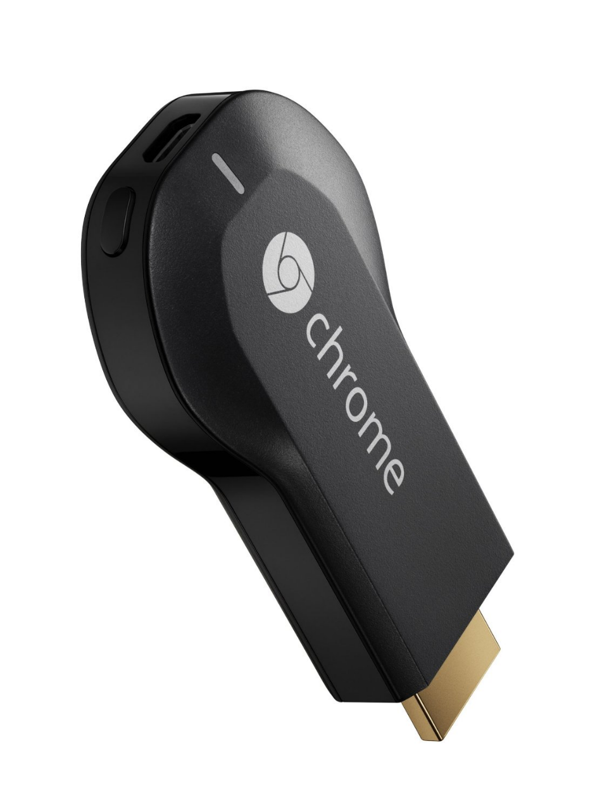
Google Cast?
Notes:
Google Cast receiver device, such as a Chromecast.

Slide 3
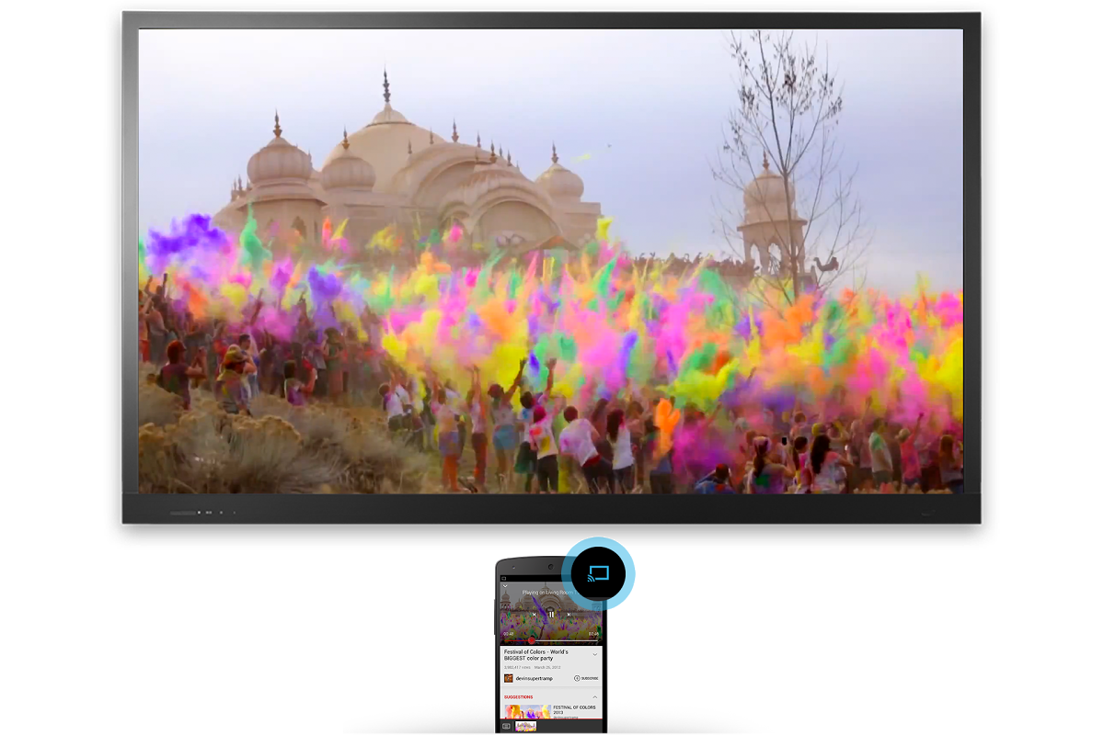
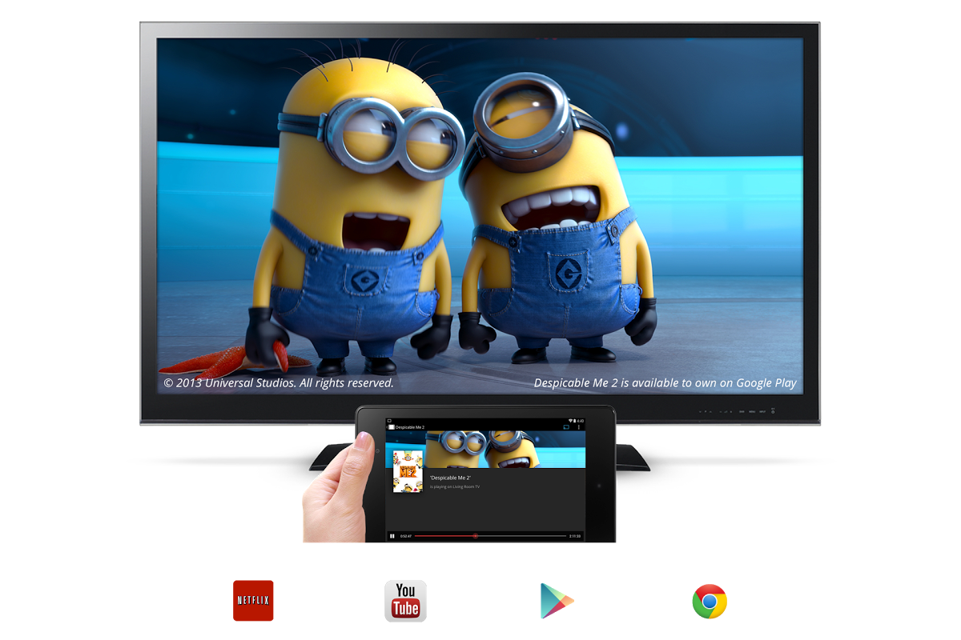
Google Cast?

Slide 4
Google Cast?
Netflix, YouTube, Google Play Movies, Music & TV
Stream on the TV
Control from Android, iOS or Chrome
Build your own apps

Slide 5
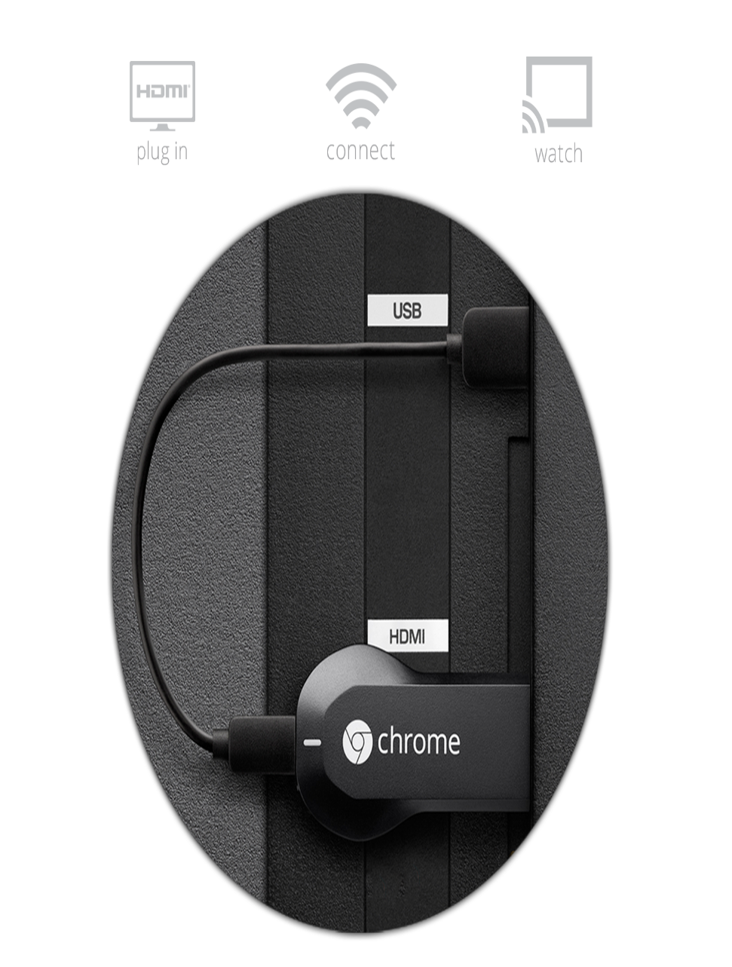
You’ll need
TV with HDMI
WiFi with Internet connection
USB power
A sender device

Slide 6
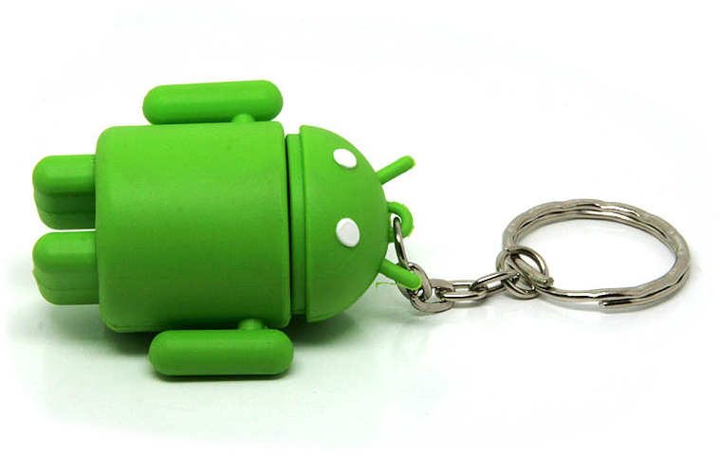
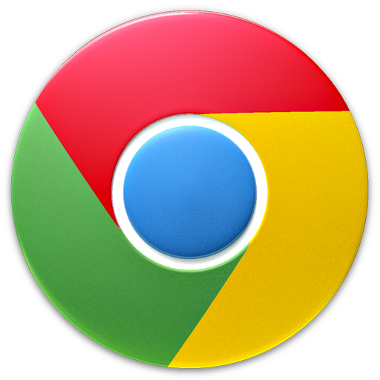
Senders & receivers
Android or iOS app using Chromecast SDK
Chrome using Chromecast extension
Single-page HTML app

Slide 7
Sending & receiving
Communication channels
Multiple sessions per receiver app

Slide 8
Flow
Disconnect from Cast device
Launch sender app
Send & receive messages
Discover Cast devices
Launch receiver app
Connect to Cast device

Slide 9
Senders
Discover Cast devices
Provide Cast button in UI
Start or join a session with a Cast device

Slide 10
Receivers
Single page HTML apps
Content loaded from the network
Internet or local WiFi
Identified by ID
Needs to talk to Google over HTTPS
Communicates with sender over message bus

Slide 11
Receiver types
Default media receiver
Media playback
Styled media receiver
Media playback + CSS
Custom receiver
Whatever you like
Needs media player lib
}
€5 registration fee per developer

Slide 12
The docs
https://developers.google.com/cast/
Design checklist Understand basic flow and avoid common pitfalls
Developer guide: sender apps Choose the type of sender app and get started with relevant samples
Developer guide: receiver apps Choose the type of receiver app and get stared with relevant samples
API Reference

Slide 13
The samples
https://github.com/googlecast
Various samples for all platforms
By Google

Slide 14
The community
Google Cast Developers community on Google+
Google engineers at the ready!
https://plus.google.com/communities/115742157569103585450
http://tiny.cc/castcommunity

Slide 15
Android sender

Slide 16
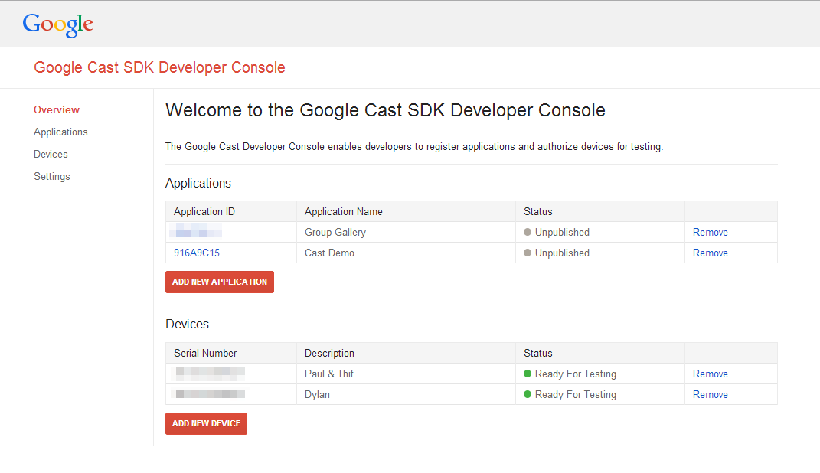
First a bit of preparation…

Slide 17
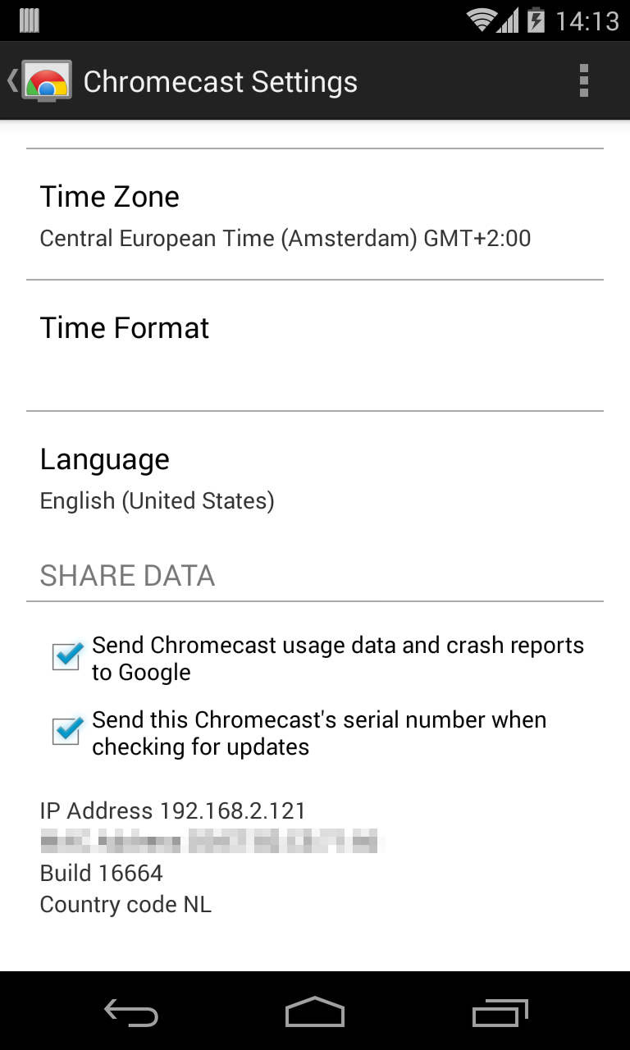
…and more preparation…
Register your device for testing by sending the serial number

Slide 18
…and even more preparation…
android-support-v7-mediarouter
Requires android-support-v7-appcompat
Google Play Services
Optional: CastCompanionLibrary
Will offload a lot of work
Loads of code; could be intimidating

Slide 19
Flow
Launch sender
Discover
Connect
Launch receiver
Send & receive
Disconnect
Disconnect from Cast device
Launch sender app
Send & receive messages
Discover Cast devices
Launch receiver app
Connect to Cast device

Slide 20

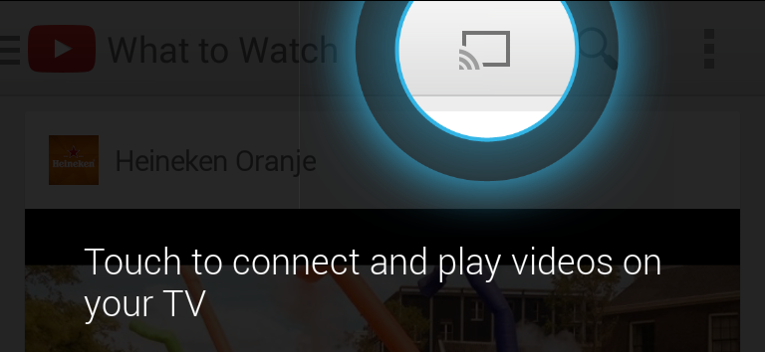
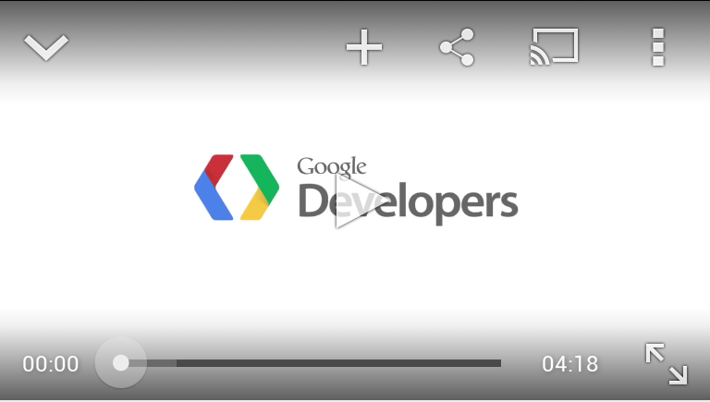
Add button for casting:
MediaRouterActionProvider
MediaRouter Button
Your own
Only show it when Cast devices are discovered

Slide 21
<menu xmlns:android="http://schemas.android.com/apk/res/android"
xmlns:app="http://schemas.android.com/apk/res-auto">
<item android:id="@+id/media_route_menu_item"
android:title="@string/media_route_menu_title"
app:showAsAction="always"
app:actionProviderClass="android.support.v7.app.MediaRouteActionProvider"/>
</menu>

Slide 22
Get the MediaRouter instance
Create a MediaRouteSelector for Cast apps
Create a MediaRouter.Callback instance

Slide 23
mMediaRouter = MediaRouter.getInstance(getApplicationContext());
// Create a MediaRouteSelector
mMediaRouteSelector = new MediaRouteSelector.Builder()
.addControlCategory(CastMediaControlIntent.categoryForCast(CAST_APP_ID))
.build();
// Create a MediaRouter callback for discovery events
mMediaRouterCallback = new MyMediaRouterCallback();

Slide 24
Add MediaRouter.Callback in onResume()
Remove MediaRouter.Callback in onPause()

Slide 25
@Override
protected void onResume() {
super.onResume();
// Add the callback to start device discovery
mMediaRouter.addCallback(mMediaRouteSelector, mMediaRouterCallback,
MediaRouter.CALLBACK_FLAG_PERFORM_ACTIVE_SCAN);
}
@Override
protected void onPause() {
// Remove the callback to stop device discovery
mMediaRouter.removeCallback(mMediaRouterCallback);
super.onPause();
}

Slide 26
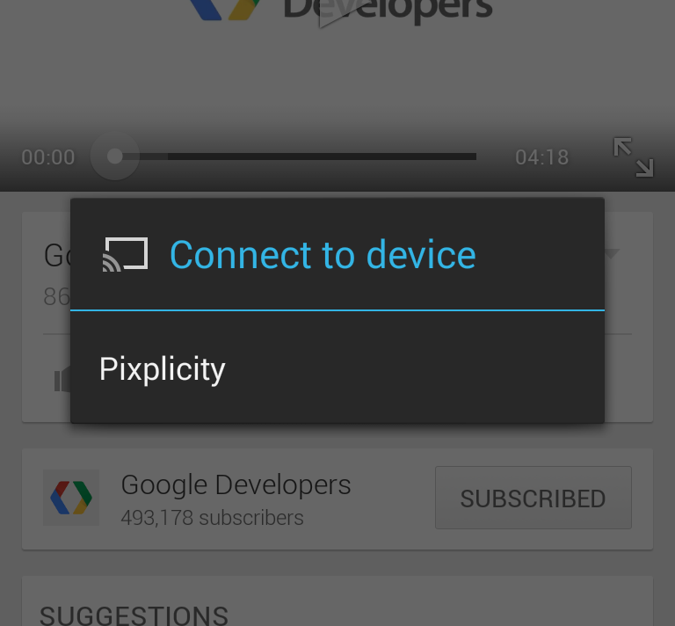
When a route is selected:
Get a CastDevice from the route
Connect a Google API Client

Slide 27
CastDevice device = CastDevice.getFromBundle(route.getExtras());
Cast.CastOptions.Builder apiOptionsBuilder = Cast.CastOptions
.builder(device, mCastListener);
Builder builder = new GoogleApiClient.Builder(mContext)
.addApi(Cast.API, apiOptionsBuilder.build())
.addConnectionCallbacks(mConnectionCallbacks)
.addOnConnectionFailedListener(...);
// Cast API requires a reference to this later on
mGoogleApiClient = builder.build();
// Do the magic
mGoogleApiClient.connect();

Slide 28
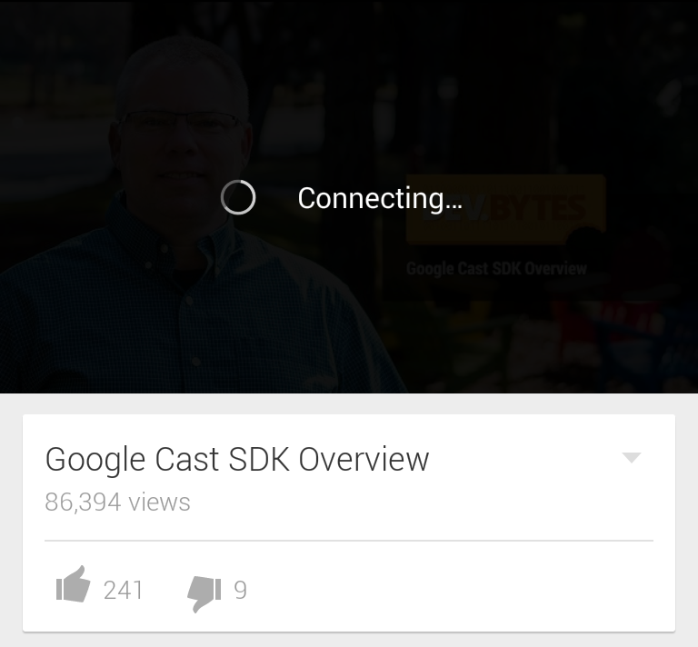
Launch Cast app or join an existing session

Slide 29
Builder builder = new GoogleApiClient.Builder(mContext)
.addApi(Cast.API, apiOptionsBuilder.build())
.addConnectionCallbacks(mConnectionCallbacks)
.addOnConnectionFailedListener(...);
ConnectionCallbacks

Slide 30
private class ConnectionCallbacks implements
GoogleApiClient.ConnectionCallbacks {
@Override
public void onConnected(Bundle connectionHint) {
launchApp();
}
@Override
public void onConnectionSuspended(int cause) {
// TODO Wait for next onConnected() and re-create the message channel
}
}

Slide 31
private void launchApp() {
PendingResult<ApplicationConnectionResult> result;
// Launch the receiver app
result = Cast.CastApi.launchApplication(mGoogleApiClient, CAST_APP_ID, false);
// For joining an existing session
//result = Cast.CastApi.joinApplication(mGoogleApiClient, CAST_APP_ID, mSessionId);
result.setResultCallback(mResultCallback);
}

Slide 32
new ResultCallback<Cast.ApplicationConnectionResult>() {
@Override
public void onResult(ApplicationConnectionResult result) {
if (result.getStatus().isSuccess()) {
mHelloWorldChannel = new HelloWorldChannel();
Cast.CastApi.setMessageReceivedCallbacks(
mApiClient,
mHelloWorldChannel.getNamespace(),
mHelloWorldChannel);
} else { /* TODO disconnect */ }
}
}

Slide 33
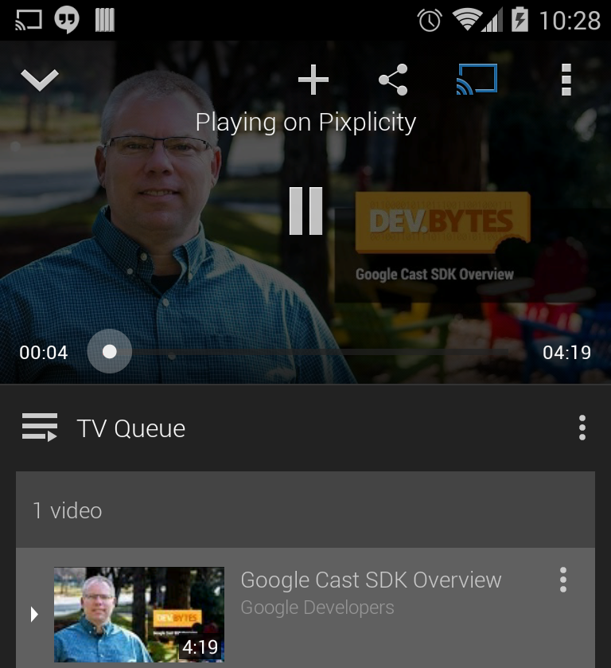
Exchange data over channel
Send messages
Receive messages

Slide 34
Cast.CastApi.sendMessage(mApiClient,
mHelloWorldChannel.getNamespace(), message)
.setResultCallback(new ResultCallback<Status>() {
@Override
public void onResult(Status result) {
if (!result.isSuccess()) {
Log.e(TAG, "Sending message failed");
}
}
});

Slide 35
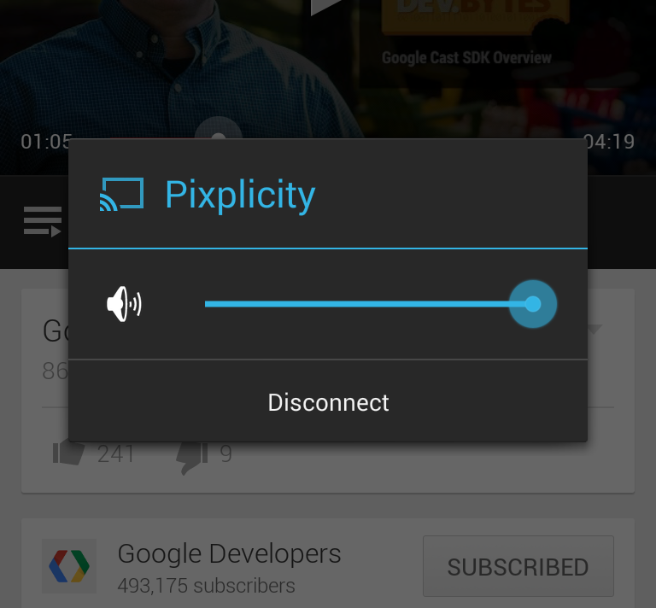
Handle disconnecting
From route unselection
From connection failure
When receiver app is stopped
onDestroy()

Slide 36
private void disconnect() {
if (mApiClient != null && mApiClient.isConnected()) {
Cast.CastApi.stopApplication(mApiClient, mSessionId);
Cast.CastApi.removeMessageReceivedCallbacks(
mApiClient,
mHelloWorldChannel.getNamespace());
mApiClient.disconnect();
mHelloWorldChannel = null;
}
mApiClient = null;
}

Slide 37
Debugging
http://<ip-address>:9222
Console
DOM inspector

Slide 38

Gotchas!

Slide 39
Gotchas!
Coping with the lifecycle asynchronously
Unexpected disconnects
Forgetting to start the MediaRouter scan

Slide 40
Useful stuff
The docs https://developers.google.com/cast/
The samples https://github.com/googlecast
The community http://tiny.cc/castcommunity

Slide 41
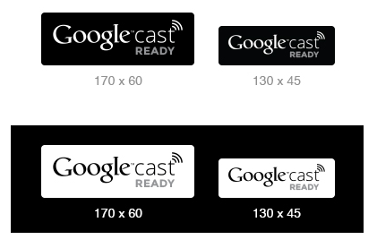
Added value

Slide 42
Google Cast App
Creating your own
Enjoy
!
Paul Lammertsma
CTO, Pixplicity

